Slide 1
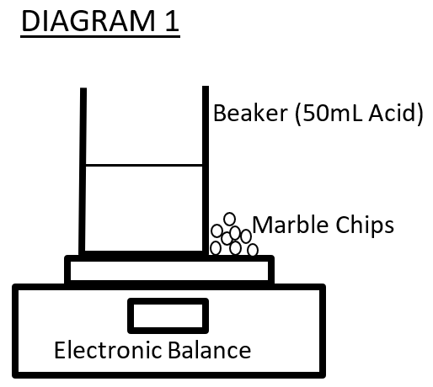
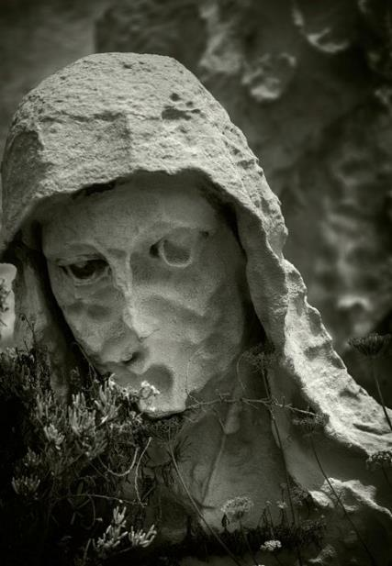
Acid rain and Calcium Carbonate structures
Group Members:
Billy the Kid; Superman; Bilbo Baggins; Albert Einstein
Method
H₂SO_{4(aq)} + CaCO_{3(s)} → CaSO_{4(s)} + H₂O_{(l)} + CO_{2(g)} Acid Calcium Calcium Water Carbon rain carbonate sulphate dioxide
1. Measure 50 mL of sulphuric acid (1.0M) and pour into the beaker.
2. Place the beaker on the electronic scales as shown in Diagram 1 (below).
3. On the electronic scales, beside the beaker add exactly 4 grams of marble chips.
4. Tare (zero) the scales so that the reading is 0.00 g
5. Pick up the Marble chips and add them (all together) to the beaker of Acid. Start the timer at this point. (The mass of the beaker will reduce so a negative mass will show on the electronic balance – this is the mass lost)
6. Stir the solution regularly for the next 3 minutes.
7. At the three-minute mark record the loss in mass of the acid and Marble Chip mixture
8. Discard this mixture and rinse and dry the beaker. Wash the marble chips thoroughly with water and dry them for reuse
9. Repeat steps 1-7 but using different concentrations of Acid - 0.8M, 0.6M, 0.5M, and 0.4M
INITIAL: How does acid rain affect statues and building made of limestone? (this is the one given in the assignment sheet)
FINAL: What effect does the concentration of sulphuric acid (from 0.4M to 1.0M) have on the rate of the reaction with calcium carbonate pebbles. (this is “designed” (restructured) and enhanced version)
Research Question:
100 mL beaker electronic scales Container of marble chips Sulphuric acid (1.0M) 25 mL Measuring Cylinder Distilled water Watch or timer
Equipment and Materials:
Independent variable:
Concentration of Sulphuric acid
Dependent variable:
Mass loss of the reaction mixture
Controlled variables:
Volume of sulphuric acid (50mL),
Time allowed for the reaction (180 seconds),
Temperature of the reactants (25⁰C),
Mass of the Marble chips (4 g),
Size and shape of the beaker used.
Variables:
Risk Assessment
Table 1: Assessment of risks faced in this experiment
As the concentration of the acid increases so does the loss in mass. This means that as the concentration of acid rain increases more calcium carbonate is lost. At a concentration of 0.4M, the mass loss was 0.19g. At double this concentration (0.8M) the mass loss was 0.38g. As the concentration of acid doubled, so did the mass lost by the marble. However this trend was not consistent for all the data.
The trend line is curved upwards - meaning at high concentrations, the mass loss was higher than expected. The curved trend shows that at a concentration of 0.5M a mass loss of just less than 0.2g is predicted. At double this concentration (1.0M), the trend line predicts a mass loss of well over 0.5g - considerably more than double the mass loss predicted at lower concentrations.
This suggests that at high concentrations of acid rain there is a much larger than expected increase in the rate of erosion of calcium carbonate structures. Conversely however, it also suggests that decreasing the concentration of acid rain (by reducing pollution) may have greater than expected benefits in reducing the erosion of such structures
ANALYSIS
Source of risk | What amount of harm could it cause? | Safety precautions taken | If an incident occurred what should I do?
Sulphuric Acid | Major Injury to eyes and skin | You fill out | You fill out
Marble Chips (calcium Carbonate) | Minor Possible cuts from edges | You fill out | You fill out
Carbon dioxide (produced) | Minor Inhalation can cause death | You fill out | You fill out
Results
The table below records the mass lost from the reaction between Sulphuric acid and the Marble chips after a time period of three minutes.
Table 2: Mass loss after three minutes – Marble chips in Acid
* This data was not used to calculate the average
Concentration of Sulphuric Acid (M) | Mass loss after 3 minutes (g)
 | Trial 1 | Trial 2 | Trial 3 | Average
1 | 0.56 | 0.53 | 0.58 | 0.56
0.8 | 0.36 | 0.37 | 0.41 | 0.38
0.6 | 0.25 | 0.11* | 0.21 | 0.23
0.5 | 0.18 | 0.19 | 0.18 | 0.18
0.4 | 0.19 | 0.2 | 0.19 | 0.19
Graph 1:
The trend line shows the relationship between the concentration of the sulphuric acid and the mass loss of the marble chips.
Conclusion
Higher concentrations of acid rain cause greater mass loss when it reacts with marble. This shows that increased pollution, and higher concentration of acid rain, will cause an increased loss of mass from Calcium Carbonate structures.
Higher concentrations of acid rain has a greater than expected effect on the Marble. This finding is significant as increases in pollution may have greater than expected effects on Calcium carbonate structures such as statues and buildings.
Evaluation of Research Question
The research question was answered by this investigation, however there should have been a greater range of concentrations of acid used. This would increase the accuracy of the upward trend noticed in the results.

